Slide 1

ObsPy is an open-source project dedicated to provide a Python framework for processing seismological data. It provides parsers for common file formats, clients to access data centers and seismological signal processing routines which allow the manipulation of seismological time series.
The goal of the ObsPy project is to facilitate rapid application development for seismology.
출처 : https://github.com/obspy/obspy/wiki

Slide 2
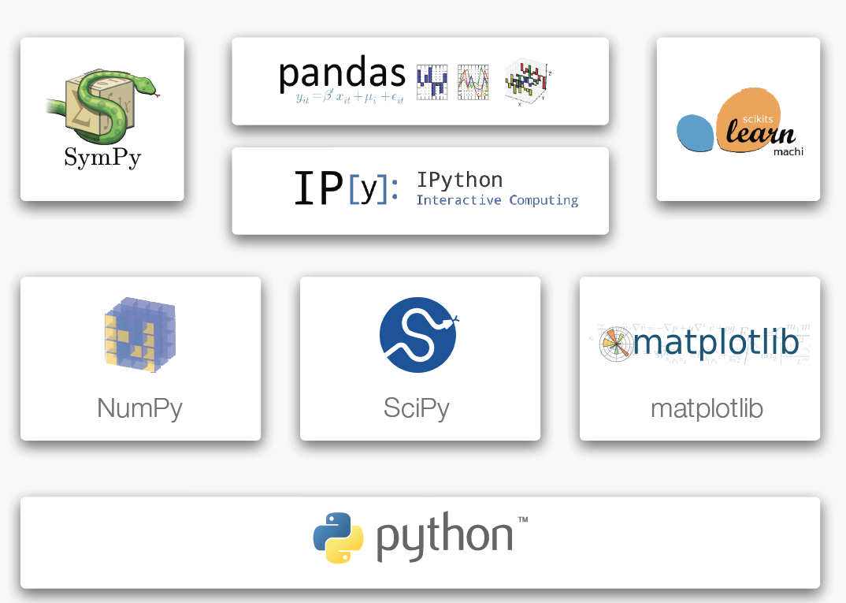
과학분야에서의 Python

Slide 3
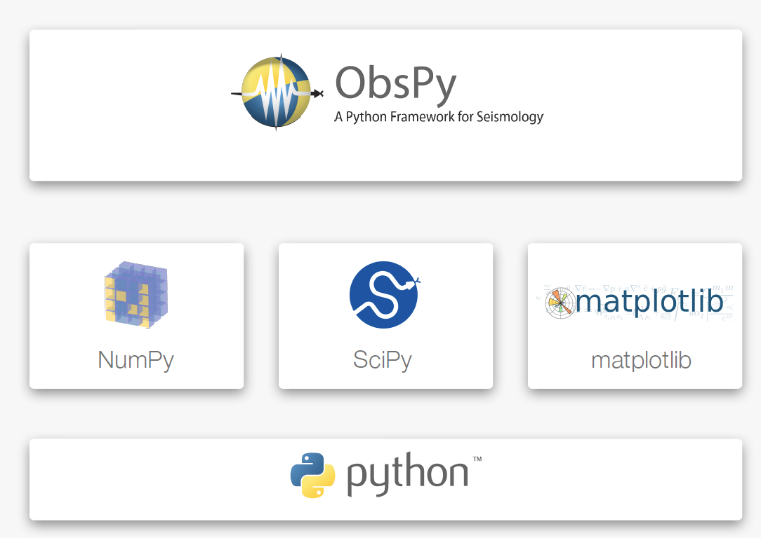
과학분야에서의 Python

Slide 4
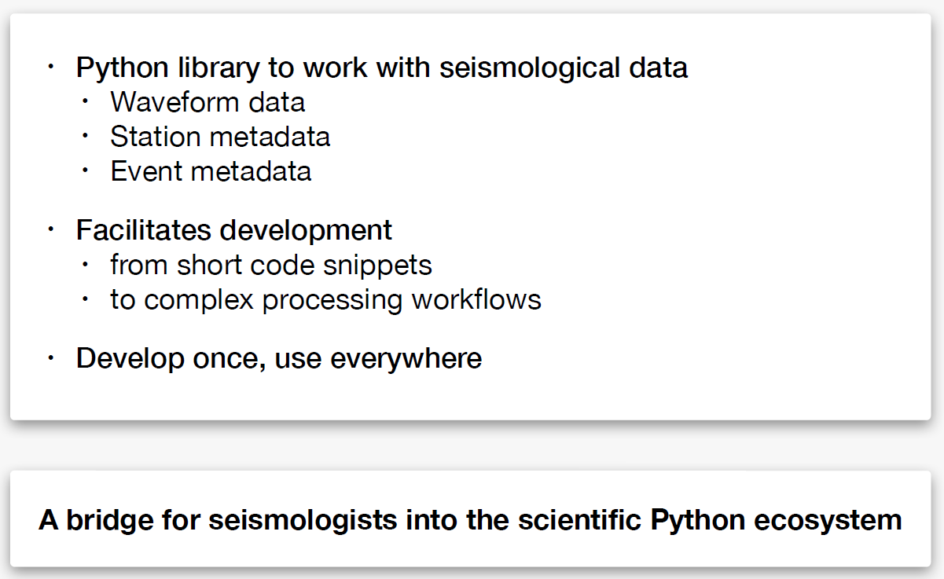
ObsPy란?

Slide 5
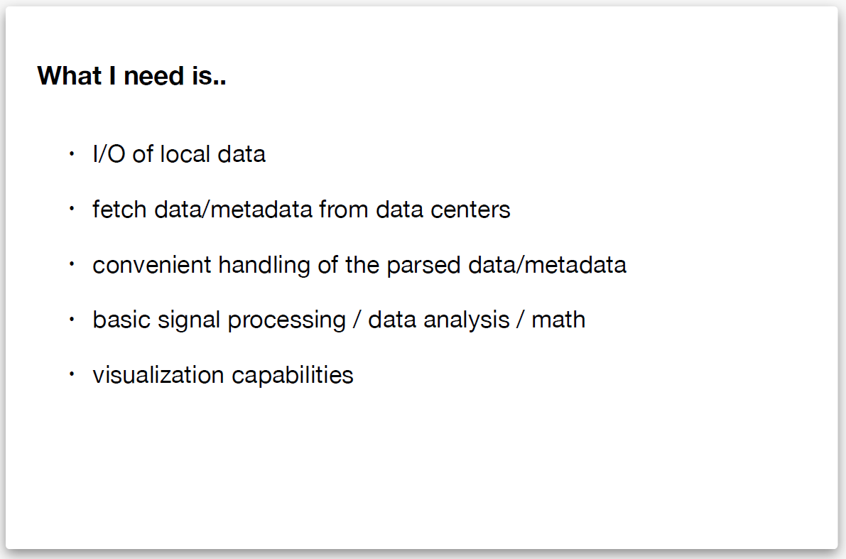
일반적인 지진자료 처리 절차
데이터 수집 및
데이터 분석
분석 결과 표출

Slide 6


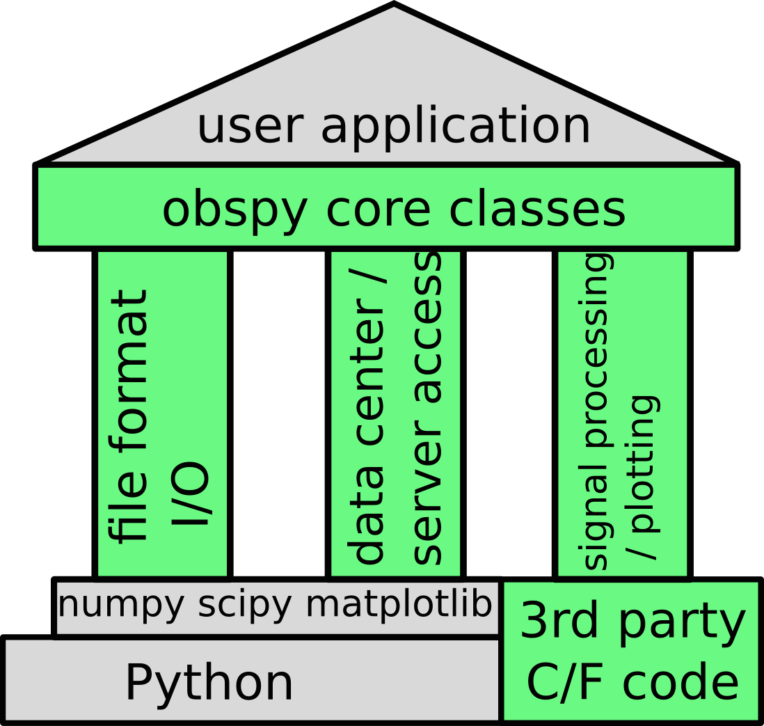
Functionality

Slide 7

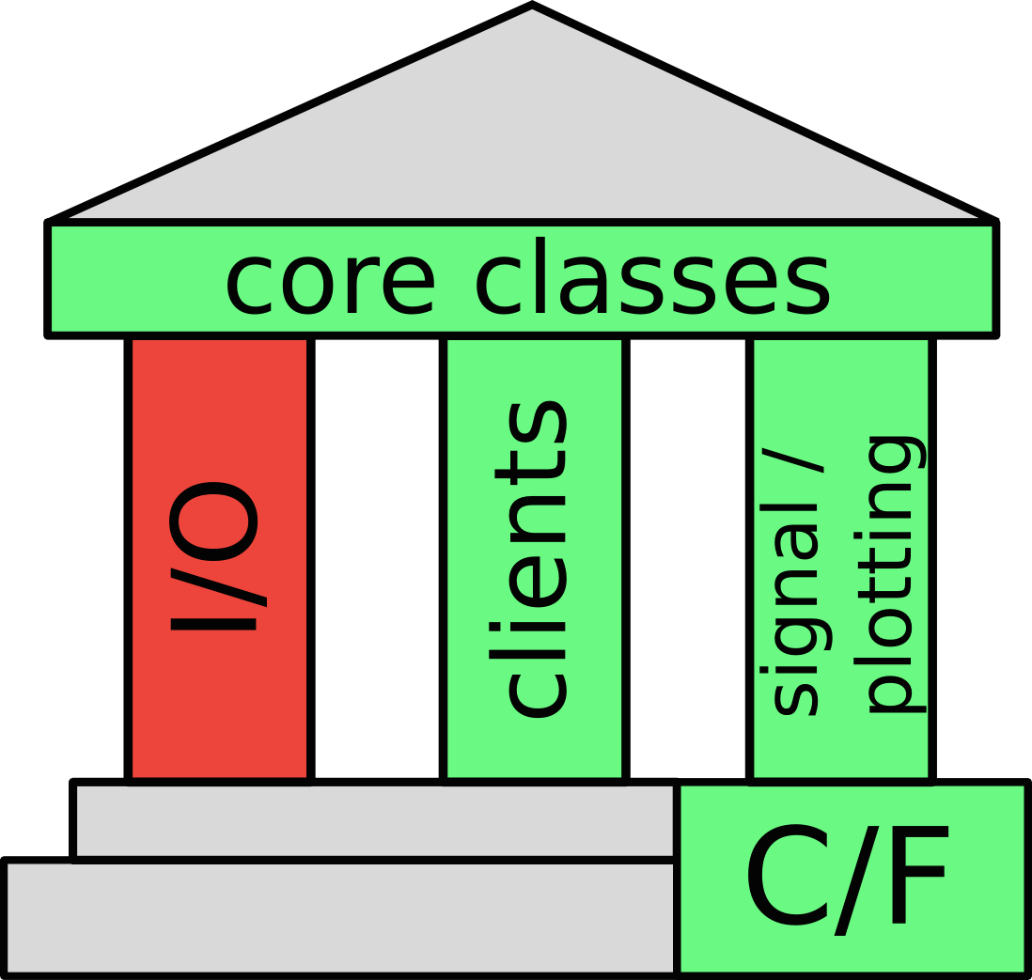
File Formats & I/O

Slide 8

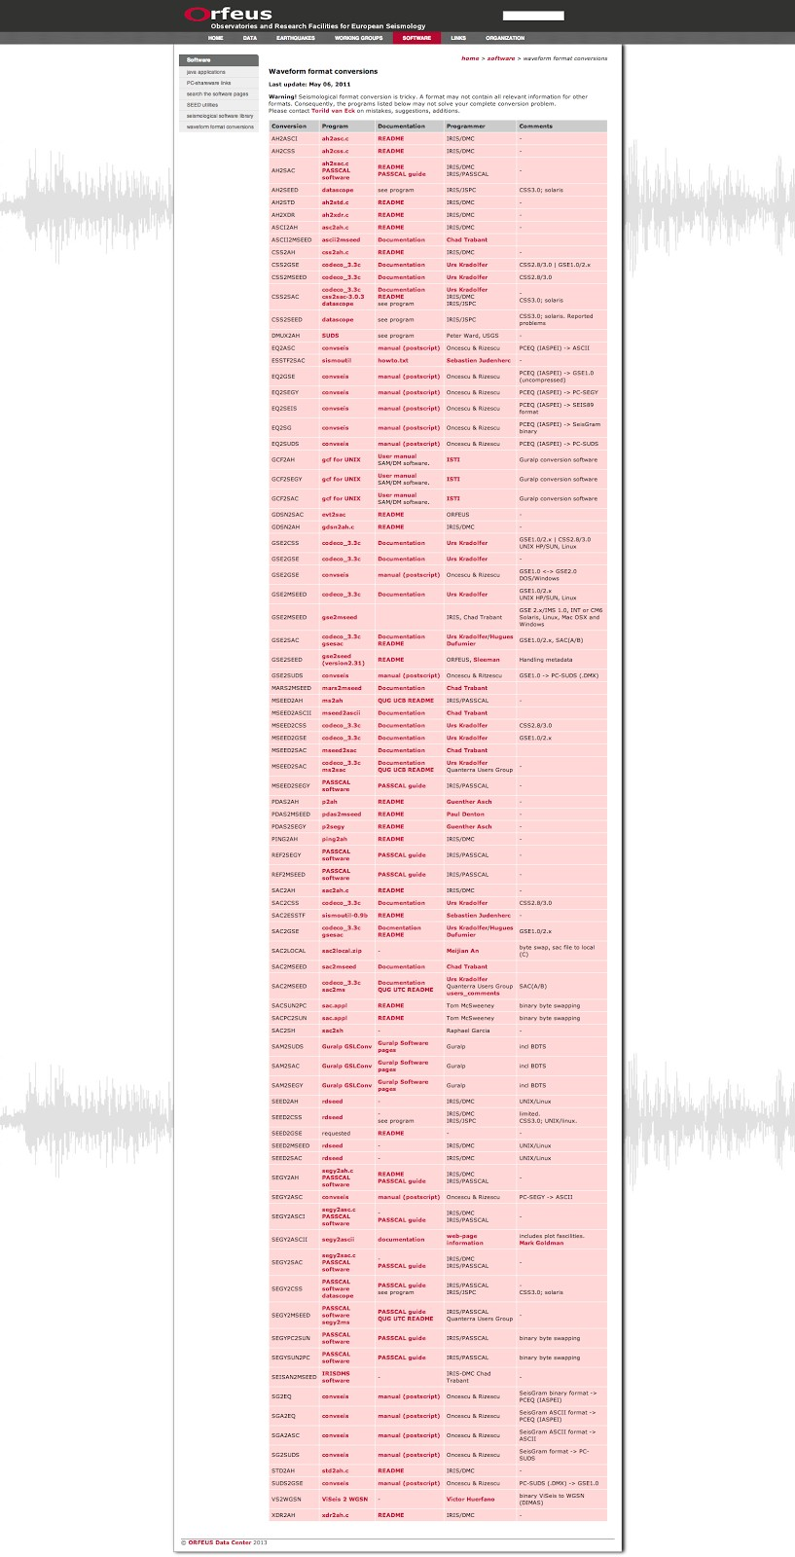

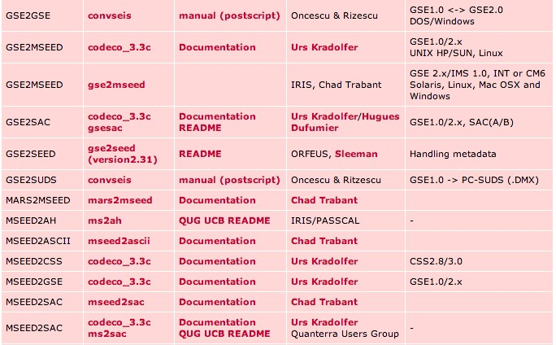

File Formats & I/O
Situation without ObsPy

Slide 9


File Formats & I/O
Situation with ObsPy
>>> import obspy
>>> st = obspy.read("/path/to/file")
•
•
•
Automatic File Format Detection Always ends up the same object Works with zipped files, URLs, …

Slide 10

File Formats & I/O
read/write support for lots of formats:
•
waveforms (MiniSEED, GSE2, SAC, …)
•
many different ways to store binary/encoded timeseries
•
station metadata ((X)SEED, StationXML, RESP)
•
complex, esp. instrument response
•
event metadata (QuakeML, NDK, PDE(Preliminary Determination of Epicenters; NEIC))
•
complex associations, owed to how data is assembled in realtime systems

Slide 11
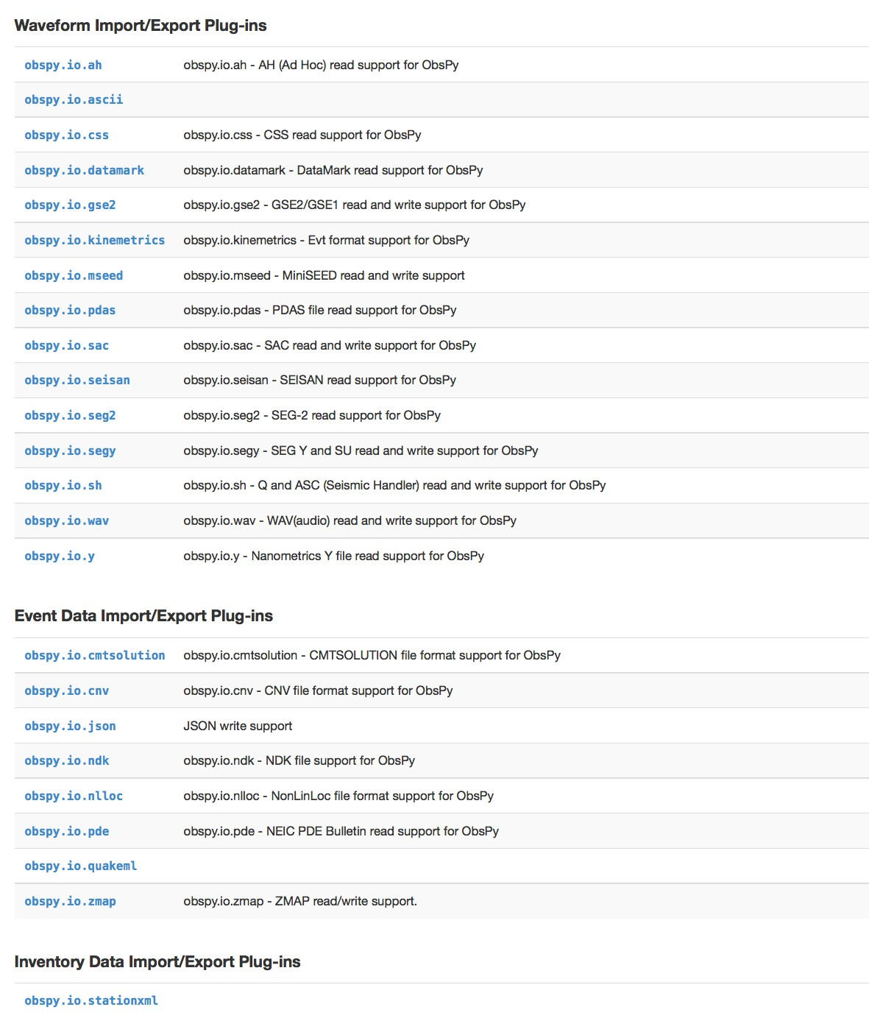
File Formats in ObsPy
ASCII
CSS
GSE2
MSEED
SAC
SEGY
WAV

Slide 12
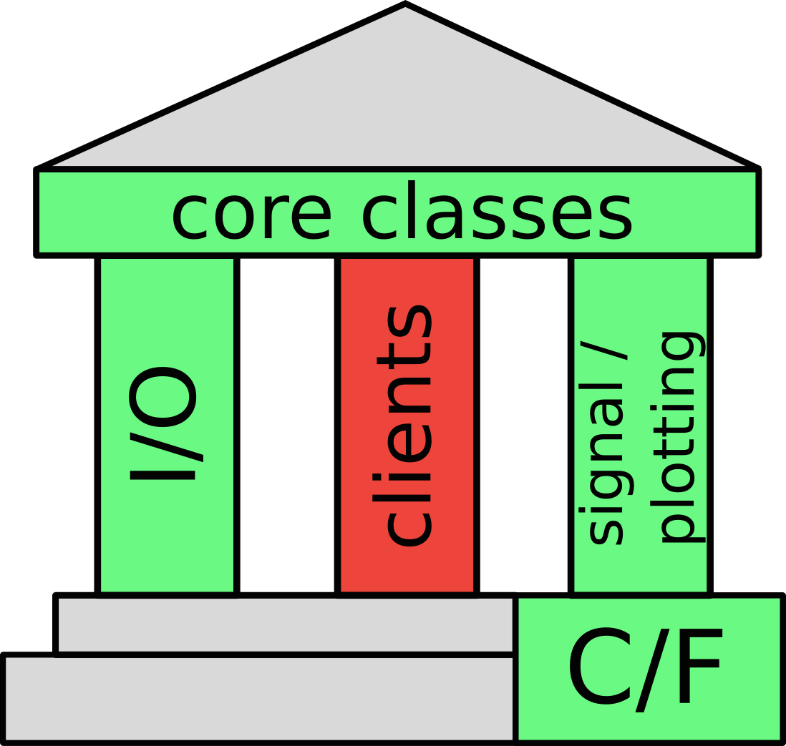

Data Acquisition

Slide 13

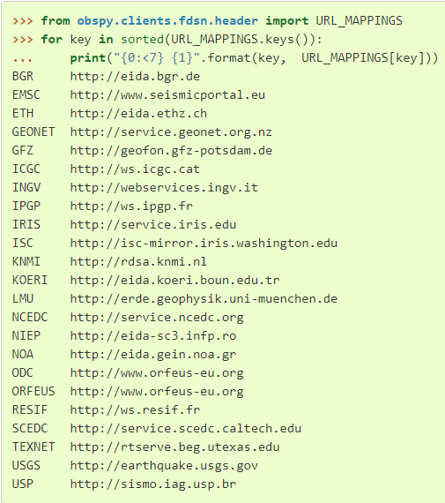
Data Center Clients
FDSN web service client
IRIS, Orfeus, USGS, RESIF, NCEDC, INGV, ...
ArcLink client
SeedLink
Earthworm
• …
⇒ different types of servers, but usage of clients very similar

Slide 14
지진 자료 서비스 구분
서비스 구분 | Available Data Types | Format | 비고
FDSN | Waveforms | miniSEED, others
 | Station Information | StationXML and Text
 | Event Information | QuakeML and Text
ArcLink | Waveforms | miniSEED, SEED | 현재 센터 내 활용 가능
 | Station Information | Dataless SEED, SEED
Earthworm | Waveforms | custom format, miniSEED
SeedLink | Waveforms | miniSEED
출처 : https://docs.obspy.org/tutorial/code_snippets/retrieving_data_from_datacenters.html

Slide 15
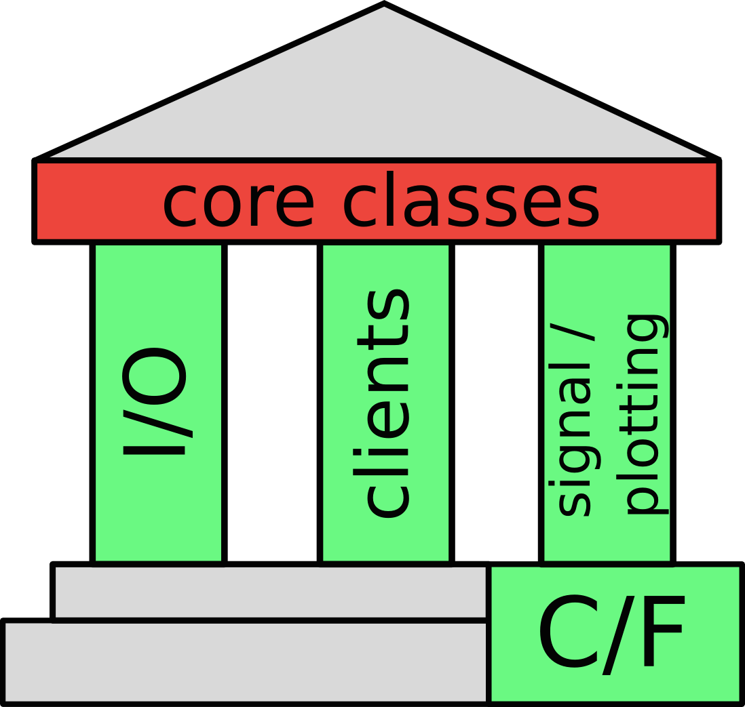
ObsPy’s Core Classes

Slide 16



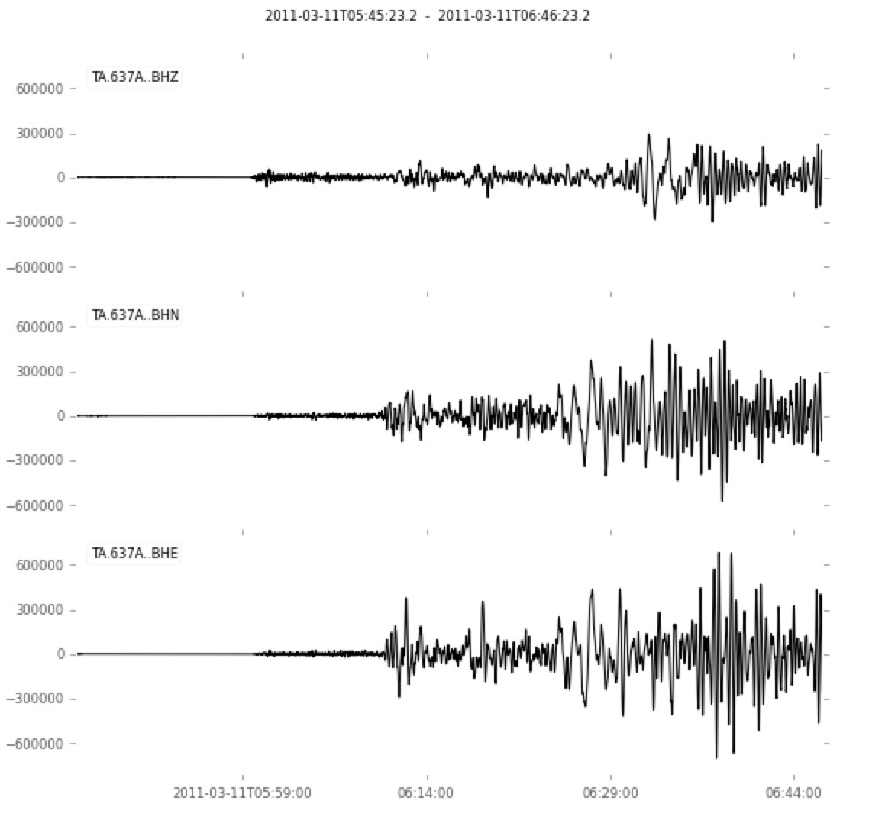
Stream/Trace for Waveforms
>>> import obspy
>>> st = obspy.read("/path/to/file")
>>> st.plot()

Slide 17
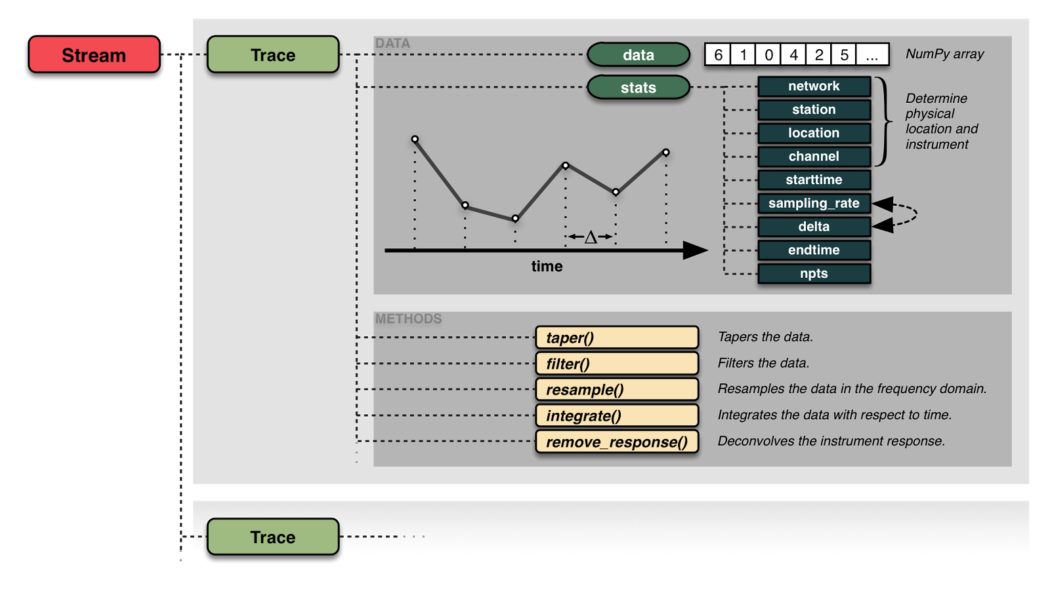
Stream/Trace for Waveforms

Slide 18





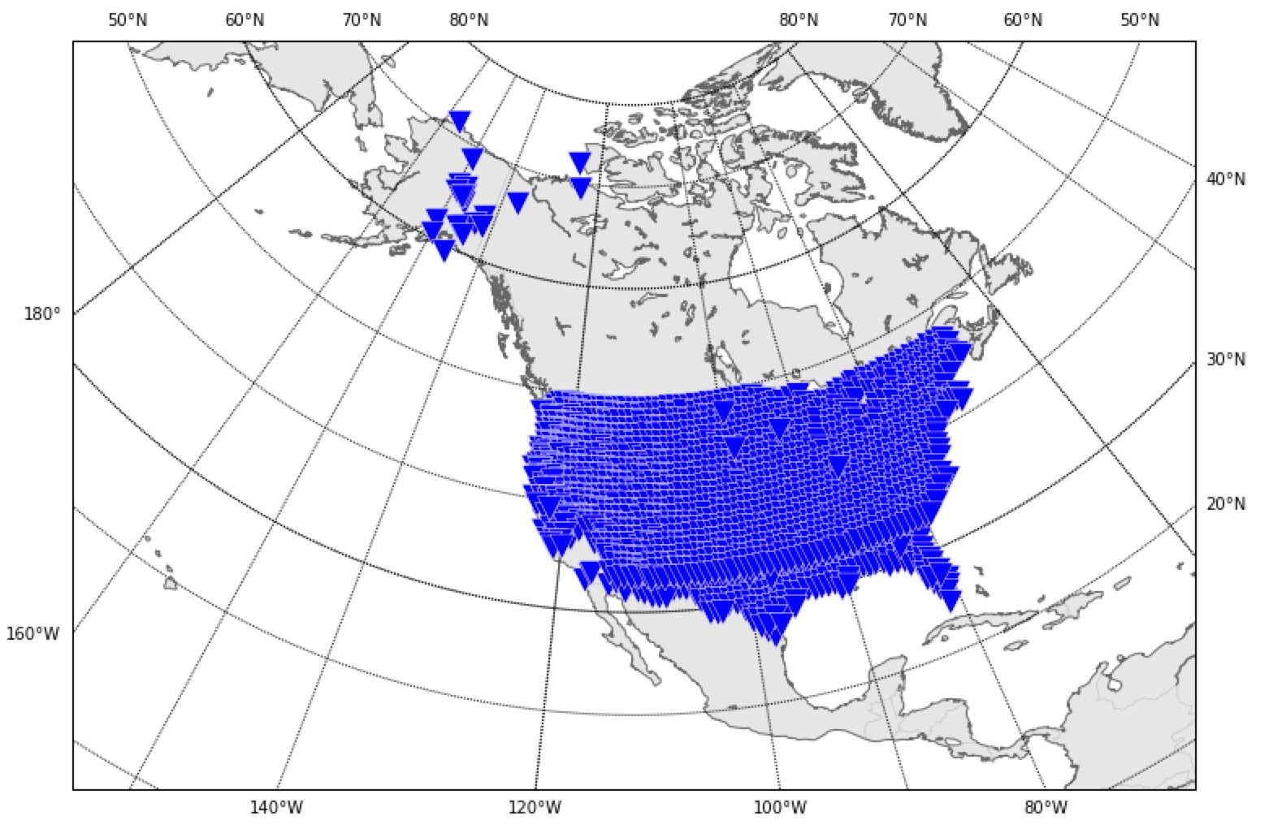
Inventory for Station Metainformation
>>> import obspy
>>> inv = obspy.read_inventory(“/path/to/file")
>>> inv.plot()

Slide 19
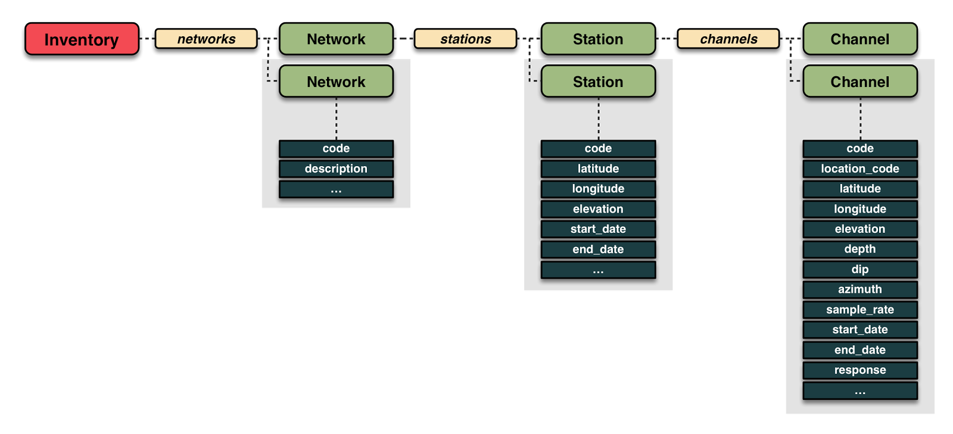
Inventory for Station Metainformation
https://docs.obspy.org/tutorial/code_snippets/stationxml_file_from_scratch.html

Slide 20





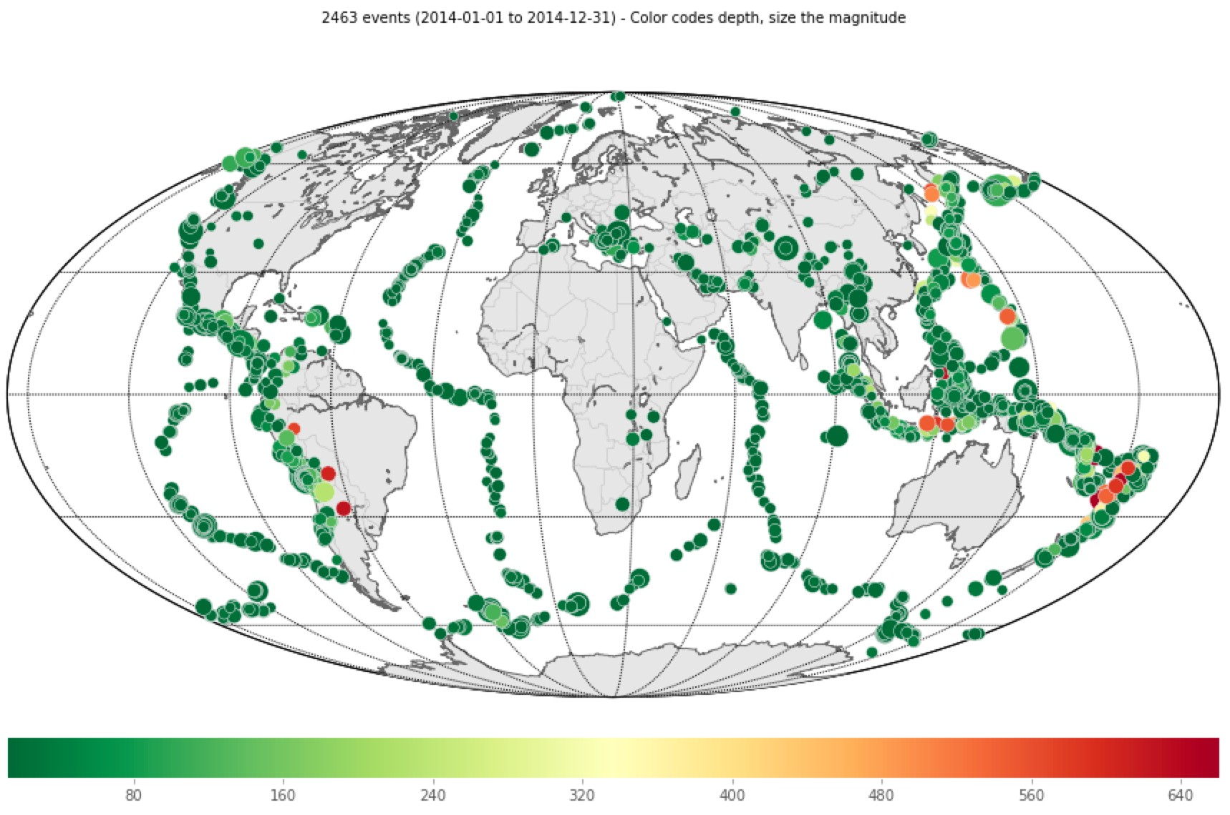
Catalog for Events
>>> import obspy
>>> cat = obspy.readEvents(“/path/to/file")
>>> cat.plot()

Slide 21
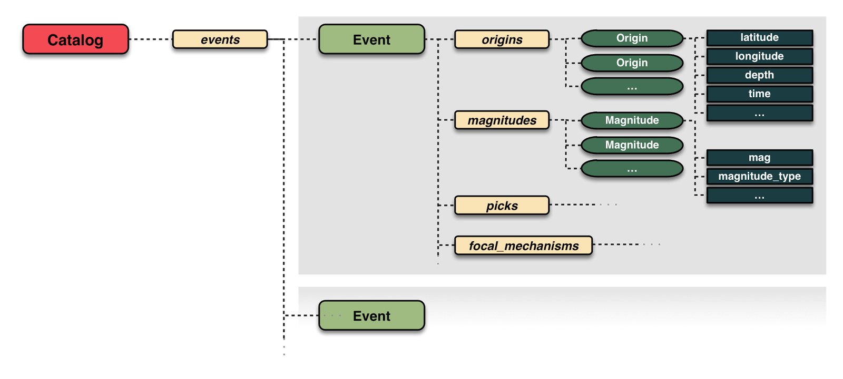
Catalog for Events
https://docs.obspy.org/packages/obspy.core.html

Slide 22
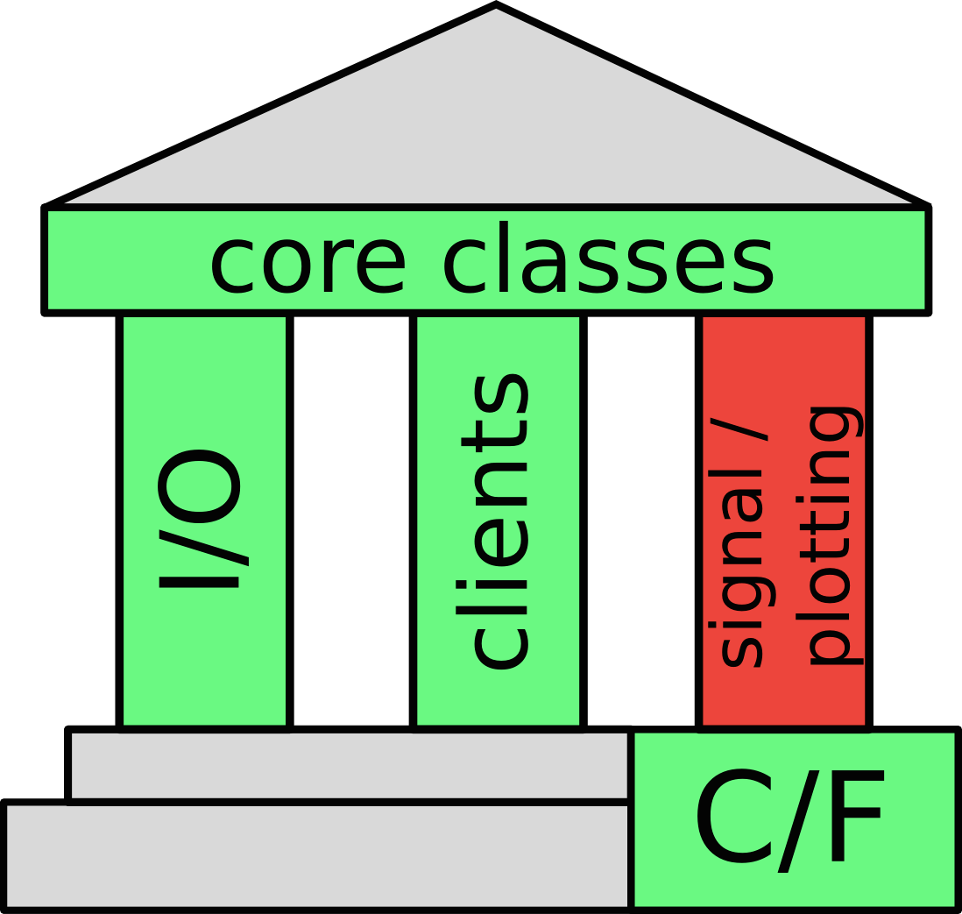
Signal Processing and Plotting

Slide 23
Signal Processing and Plotting
Basic signal processing:
•
•
•
•
•
•
trim, merge, rotate, ...
filter, resample, instrument correction array analysis, cross correlations different types of triggers probabilistic power spectral densities
…
Basic plotting:
•
•
•
waveform preview plots
stations/events location plots channel instrument response plots (bode plots)
ObsPy Library Reference
https://docs.obspy.org/packages/index.html

Slide 24



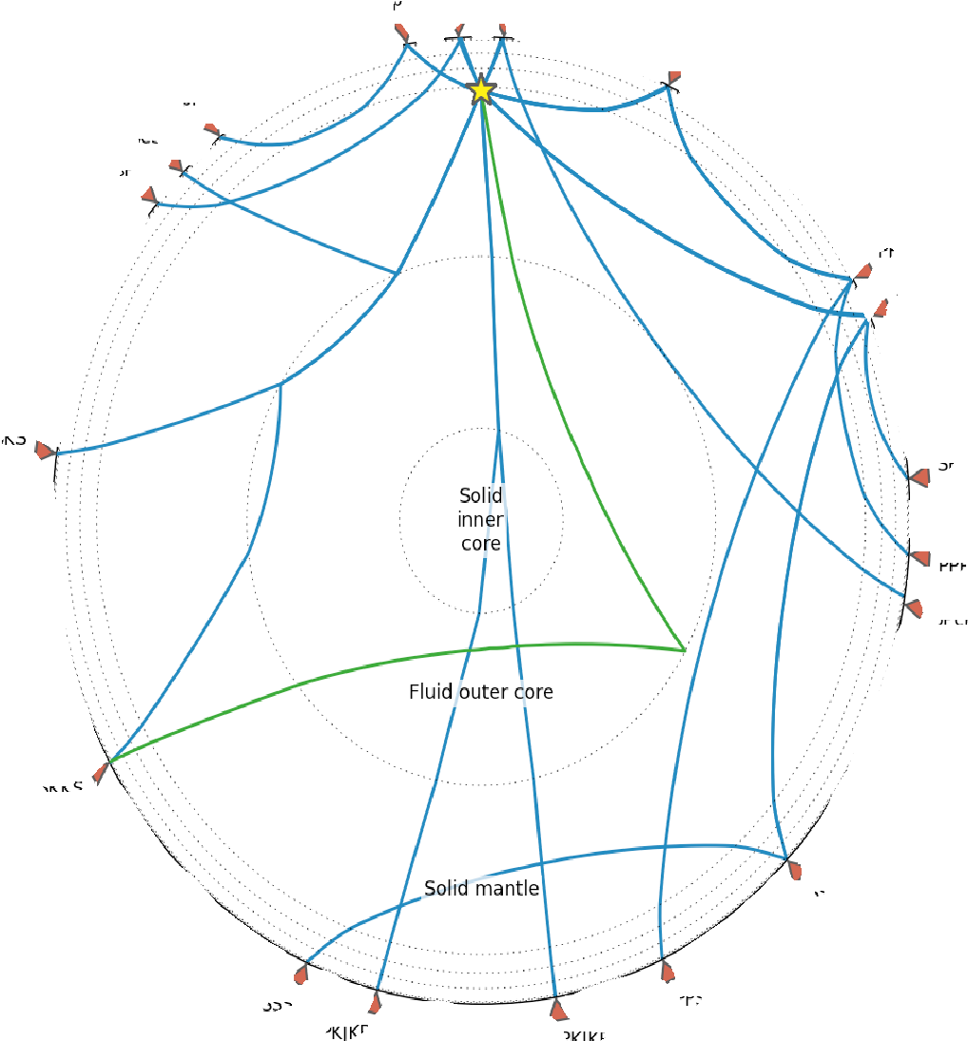
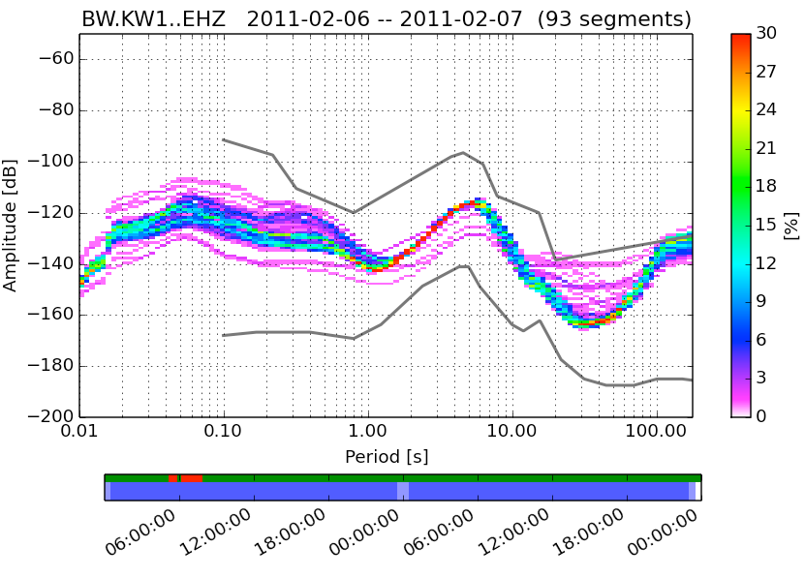
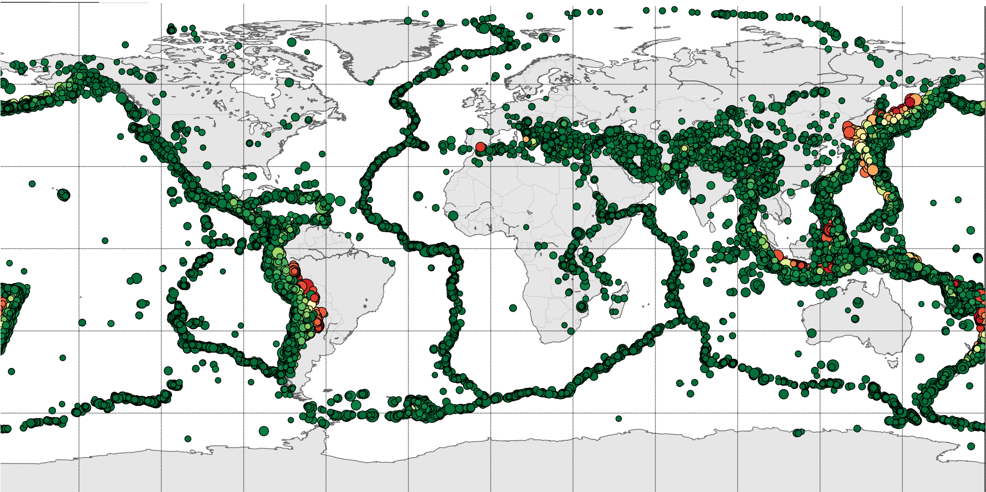



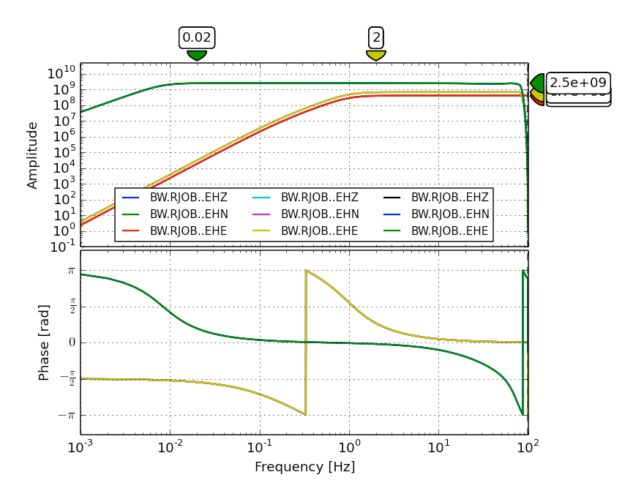
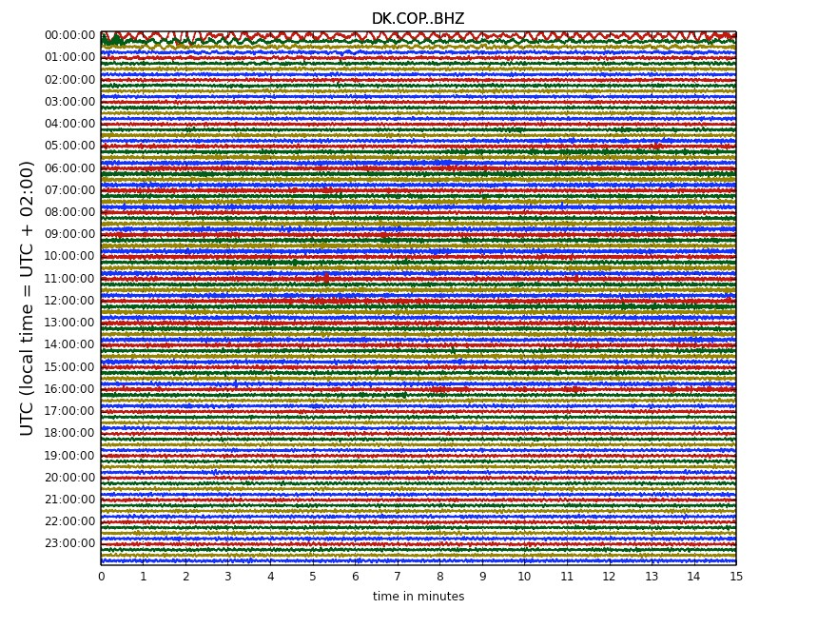
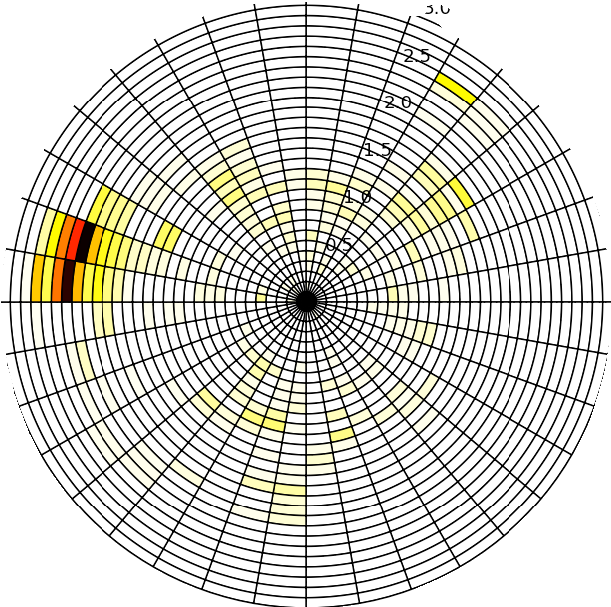

Showcase
http://docs.obspy.org/gallery.html

Slide 25

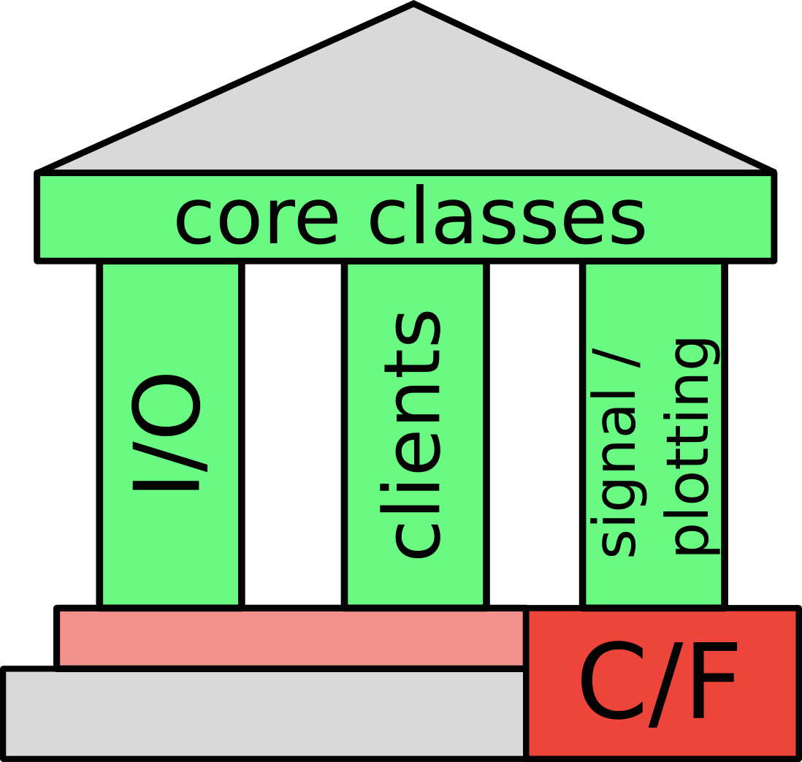
Wrap C and Fortran codes

Slide 26

Wrap C and Fortran codes
3rd party code:
•
•
don’t reinvent the wheel
reuse well established and maintained code
we use:
•
•
NumPy: fast array operations (BLAS and Lapack) SciPy: signal processing routines (UMFPACK, …)
•
•
•
libmseed: MiniSEED I/O (IRIS)
evalresp: instrument correction (ISTI/IRIS)
GSE_UTI: GSE2 I/O (Stange et al.)

Slide 27







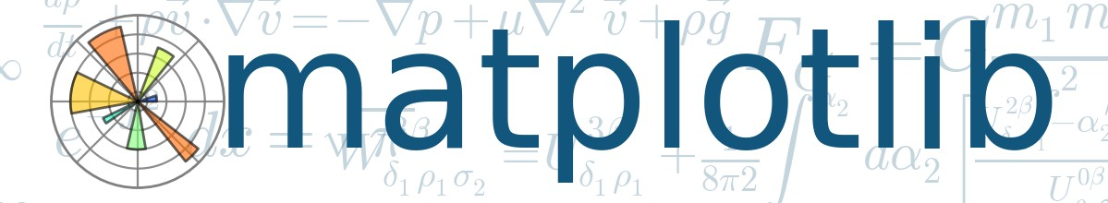



ObsPy Stack
NumPy
SciPy
matplotlib

Slide 28




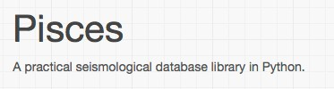




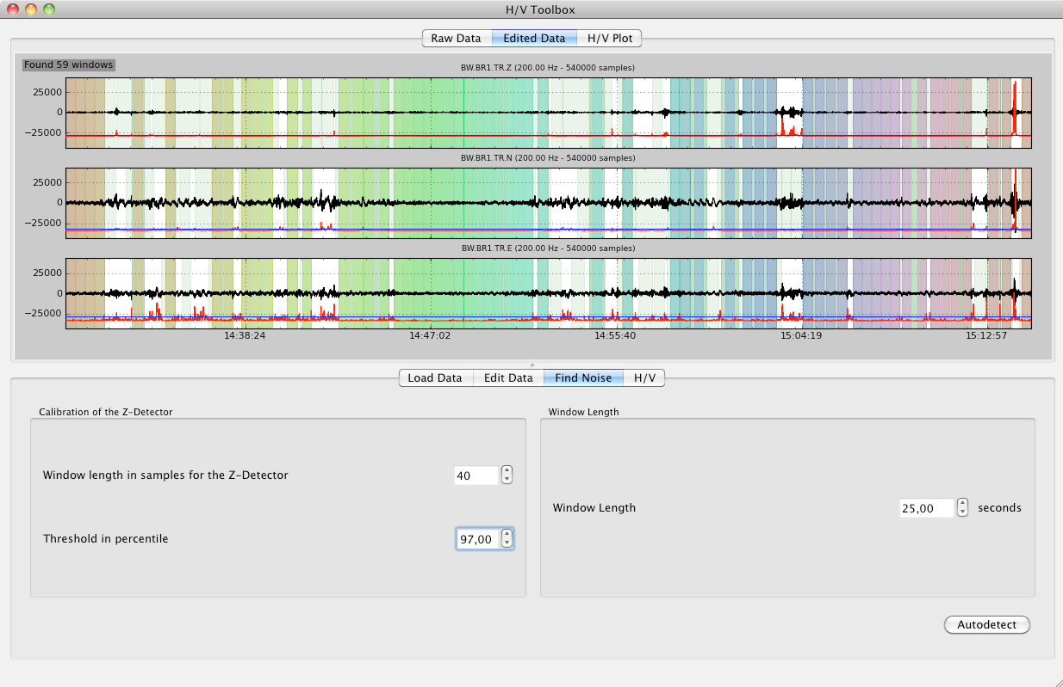
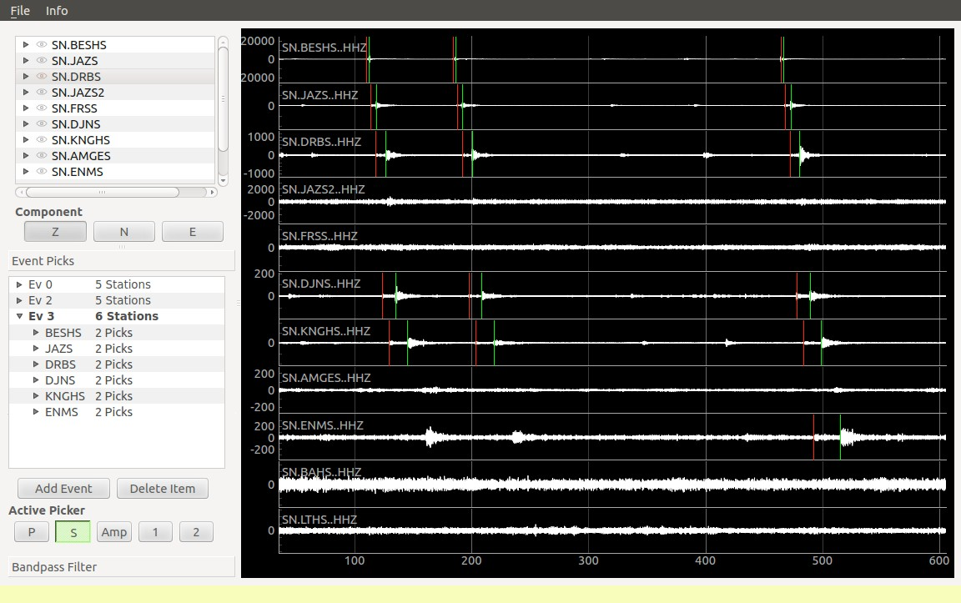

ObsPy Stack
MSNoise

Slide 29




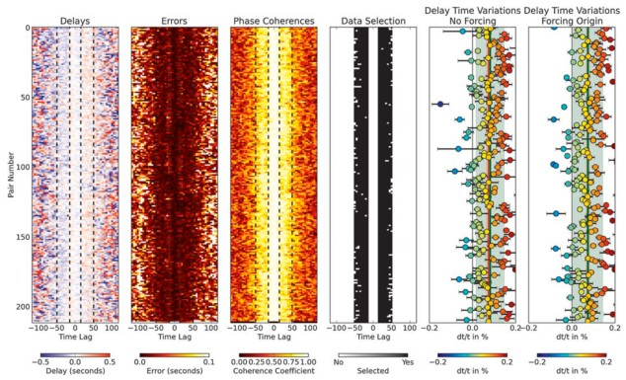
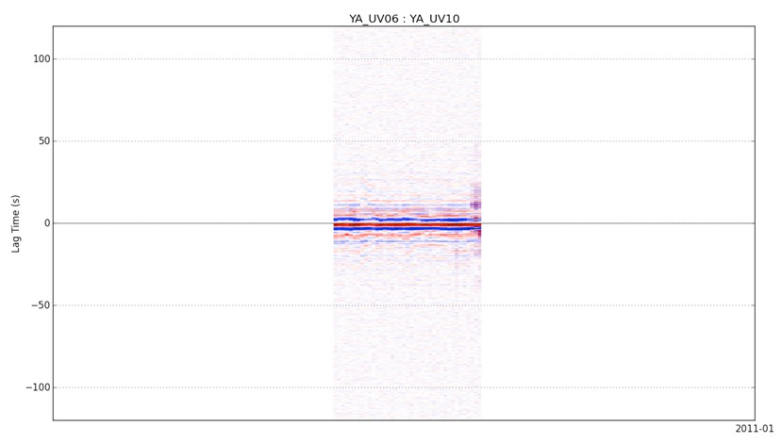
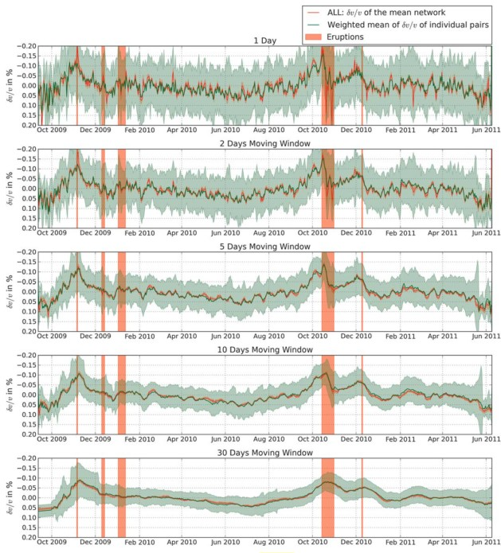
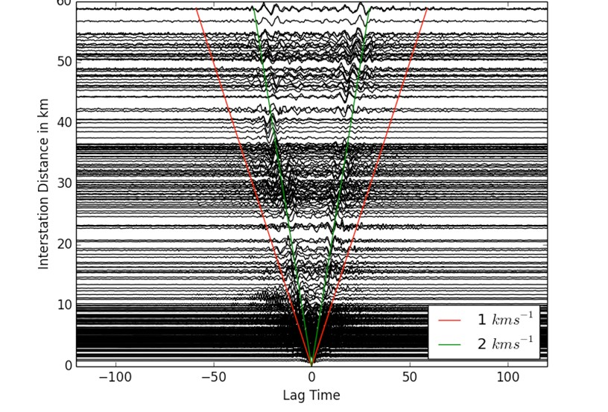
MSNoise
•
A Python Package for Monitoring Seismic Velocity Changes using Ambient Seismic Noise
Runs continuously on a couple sides world-wide
MSNoise
•
www.msnoise.org
Lecocq, T., Caudron, C., & Brenguier, F. (2014).
MSNoise, a Python Package for Monitoring Seismic Velocity Changes Using Ambient Seismic Noise.
Seismological Research Letters, 85(3), 715–726.

Slide 30

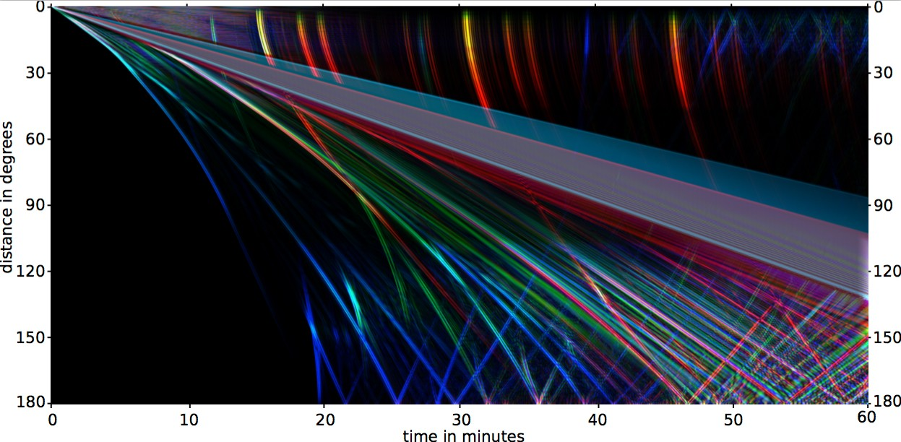

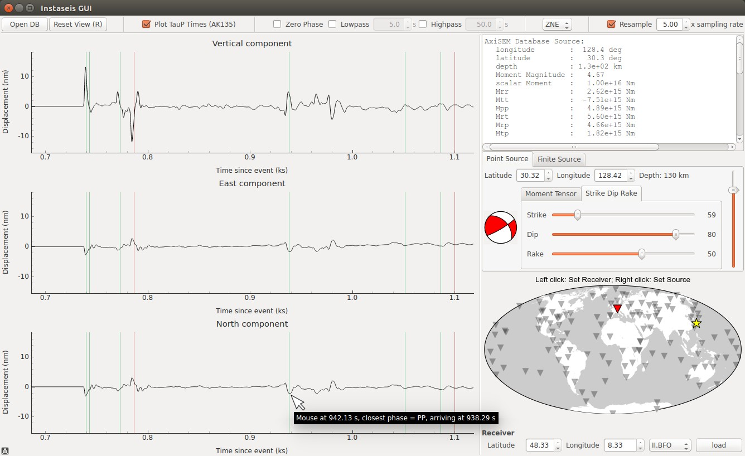
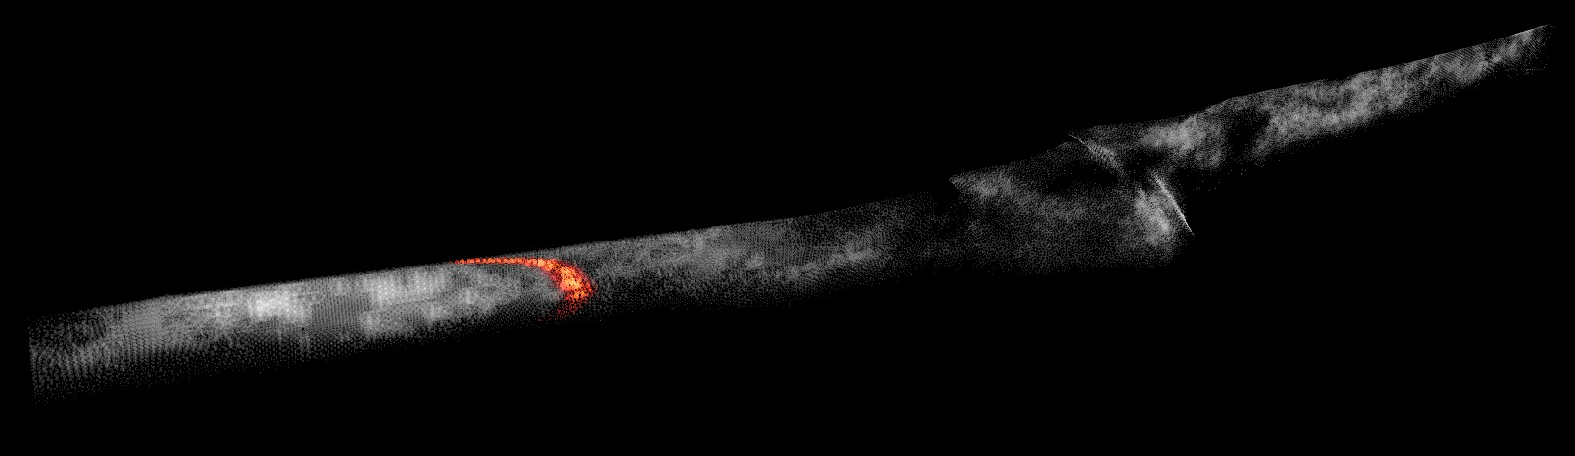
Instaseis
•
Rapid generation of high-frequency seismograms in a 1D background model
www.instaseis.net
van Driel, M., Krischer, L., Stähler, S. C., Hosseini, K., and Nissen-Meyer, T. (2015). Instaseis: instant global seismograms based on a broadband waveform database.
Solid Earth. 6, 701-717

Slide 31


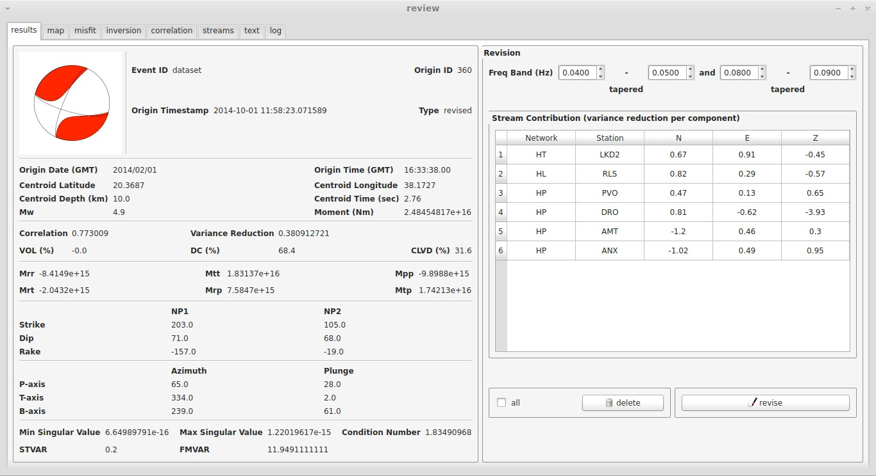

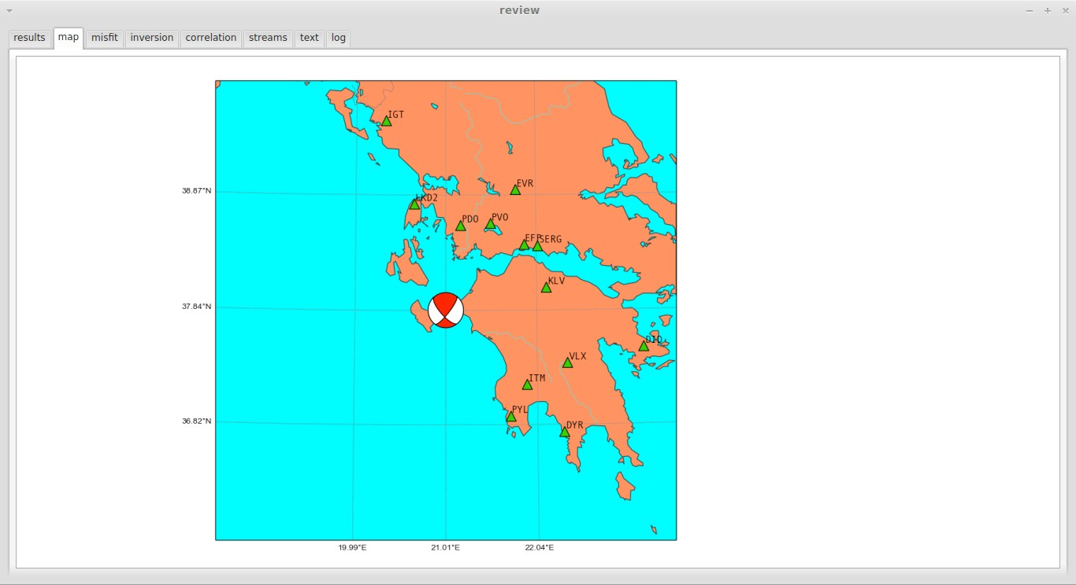

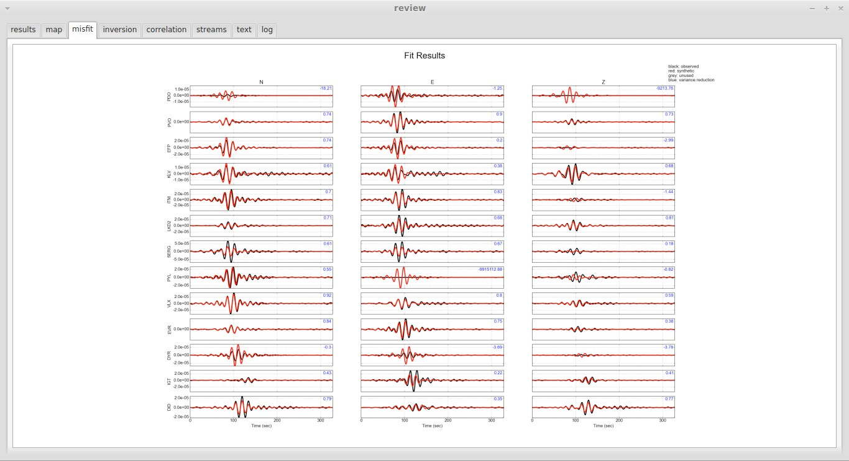
Scisola
•
Software for automatic moment tensor calculation of events which are provided in real time by SeisComP3
http://students.ceid.upatras.gr/
~triantafyl/scisola/

Slide 32

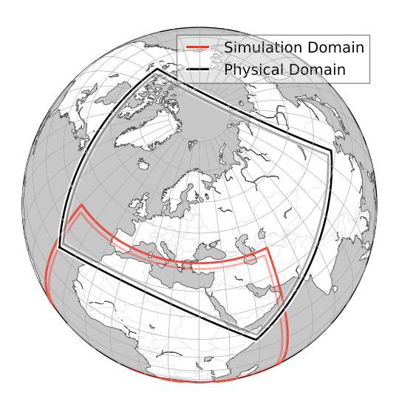
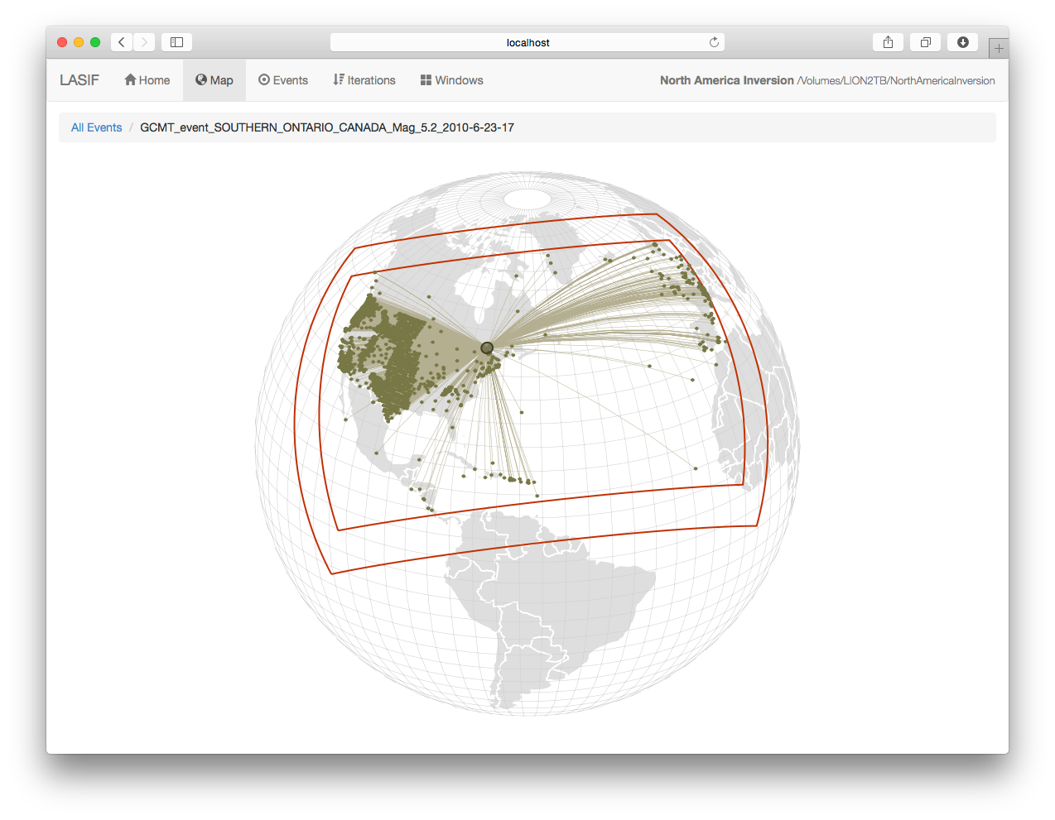
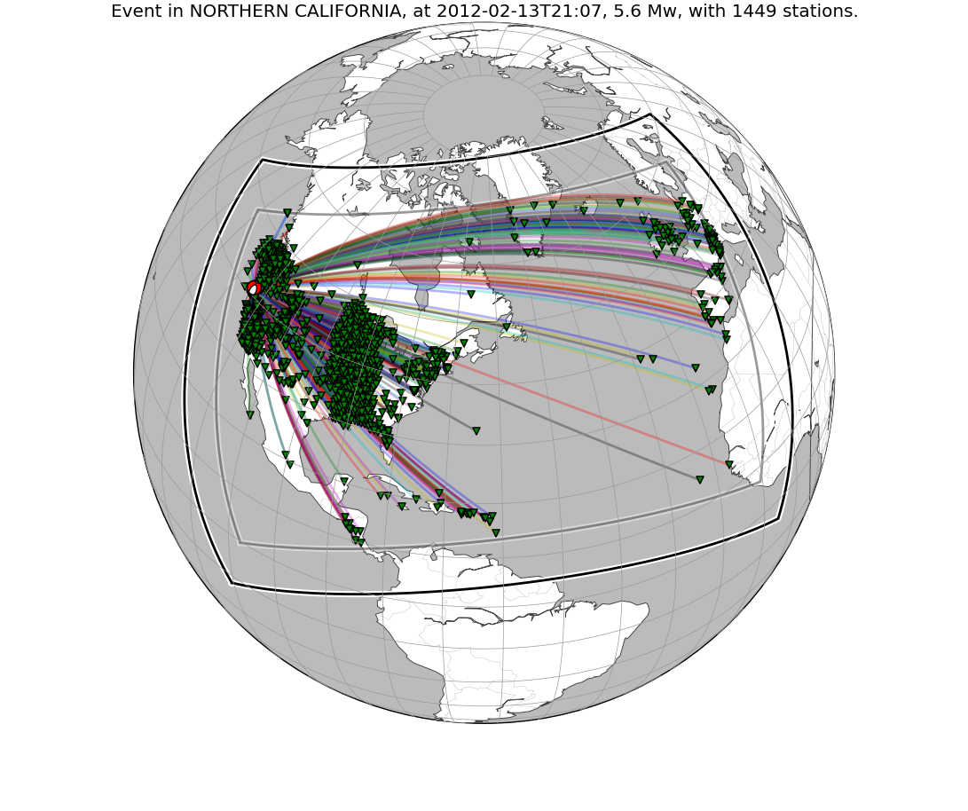
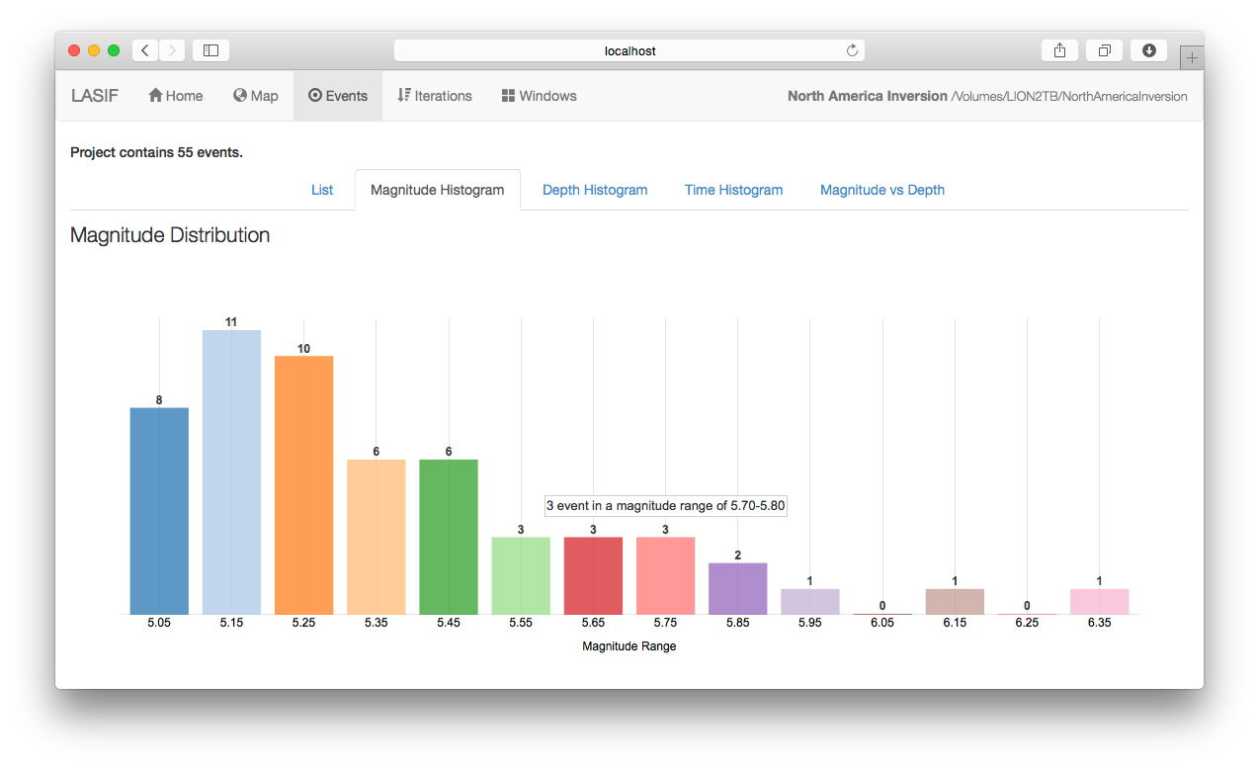
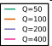
LASIF(LArge-scale Seismic Inversion Framework)
•
Framework to deal with data handling, organization, and provenance in the context of iterative inversions
Enhances reproducibility
Enables collaboration
Aims to significantly reduce the time to research
•
•
•
www.lasif.net
Lion Krischer, Andreas Fichtner, Saule Zukauskaite, and Heiner Igel (2015), Large‐Scale Seismic Inversion Framework, Seismological Research Letters, doi:10.1785/0220140248.

Slide 33



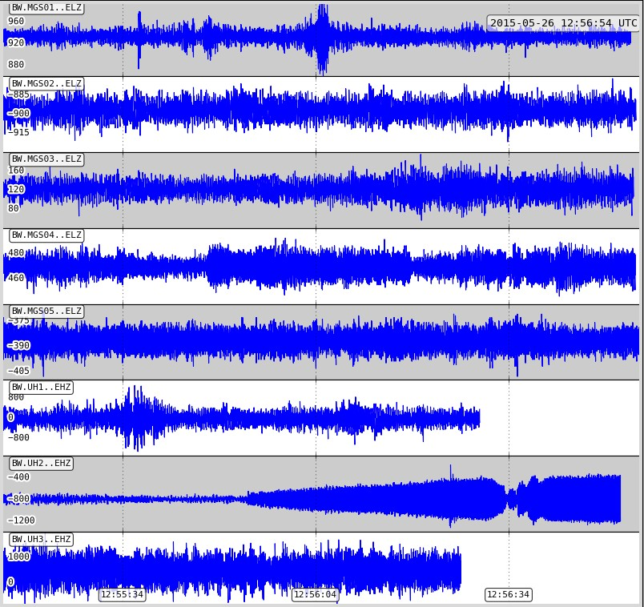
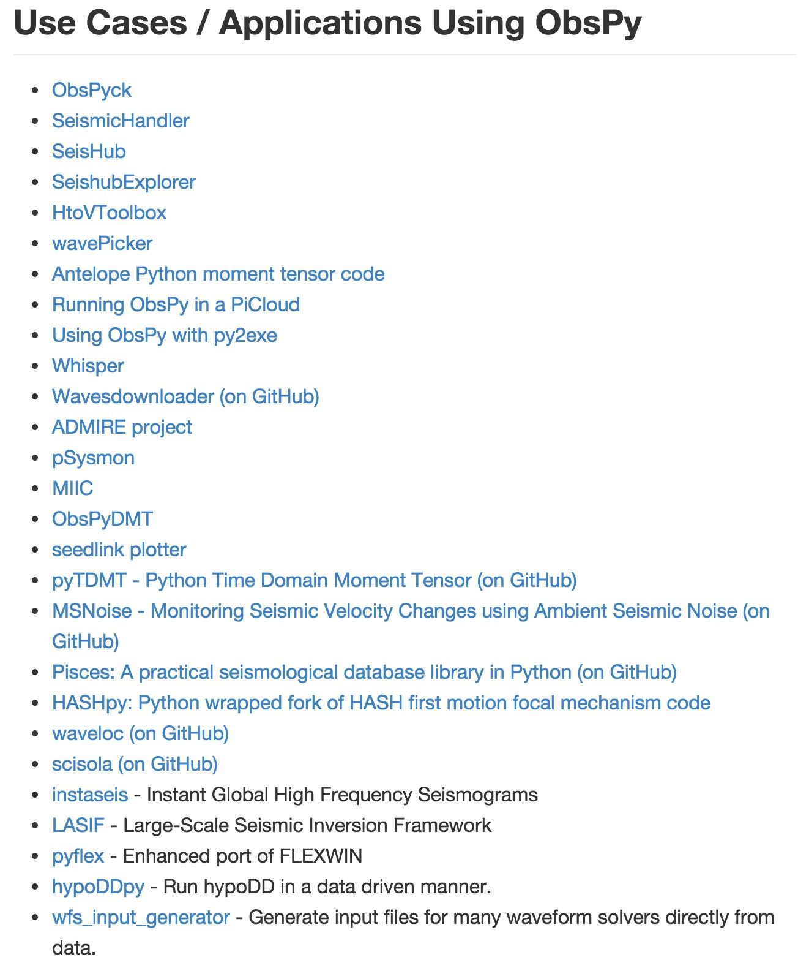



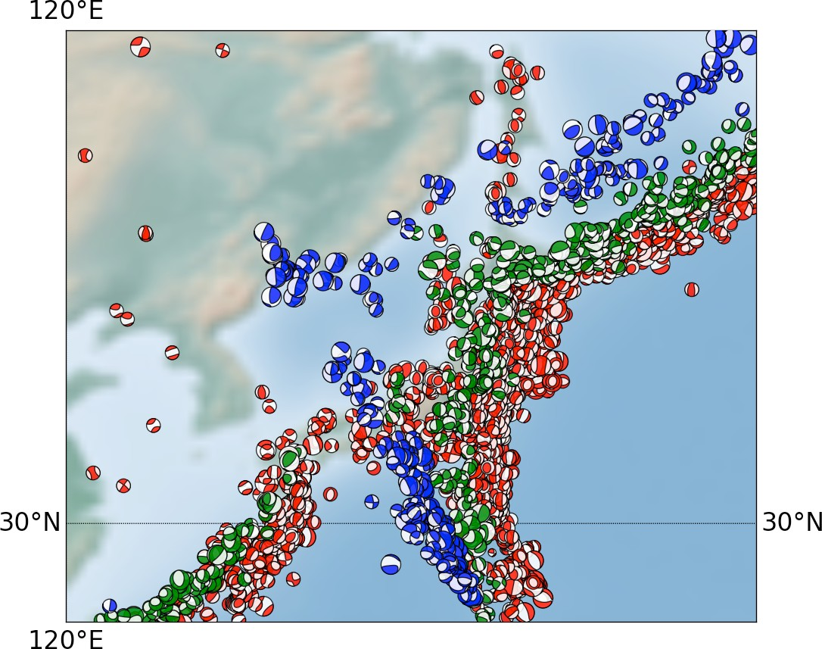
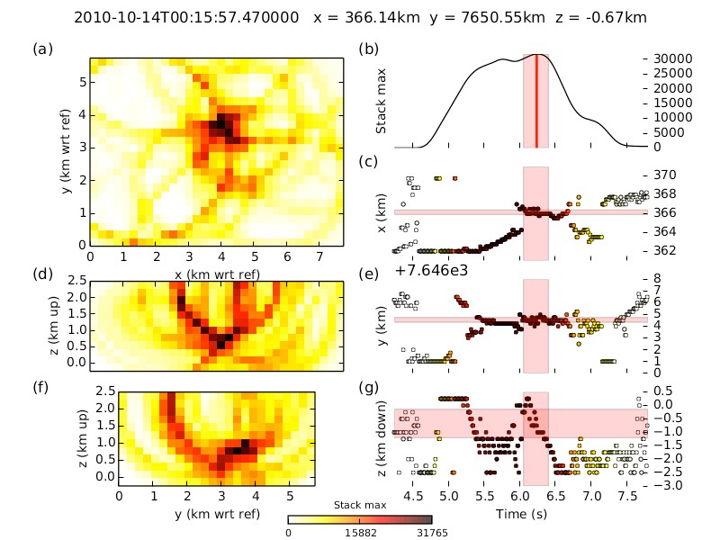


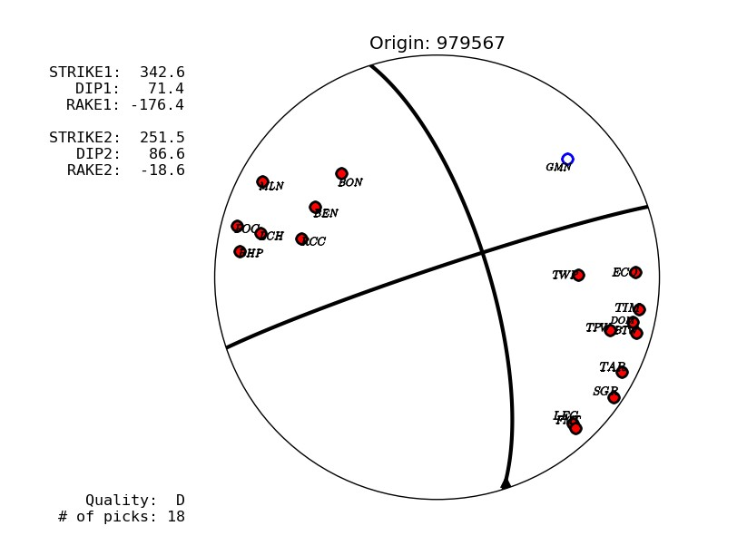

Lots of other stuﬀ
https://github.com/obspy/obspy/wiki

Slide 34


Documentation
docs.obspy.org

Slide 35











Installation
$ conda install -c obspy obspy
Installers/Packages for many platforms as well
설치 URL 참고 자료 : https://github.com/obspy/obspy/wiki/Installation-via-Anaconda

Slide 36












Do People Use It?
Each point represents one city where at least one person used ObsPy to download data from IRIS.
Mailing List
GitHub
Python Package Index
Conda Installations

Slide 37













Publications using ObsPy
Currently ~ 125
Many don’t cite us :-(
Applications include event (re)locations, ambient seismic noise analysis, seismic tomography, rotational seismology studies,
time-dependent seismology, big data processing, attenuation kernels, …
MacCarthy, J. K., & Rowe, C. a. (2014).
Pisces: A Practical Seismological Database Library in Python.
Seismological Research Letters, 85(4), 905–911.
Grigoli, F., Cesca, S., Amoroso, O., Emolo, A., Zollo, A., & Dahm, T. (2013). Automated seismic event location by waveform coherence analysis. Geophysical Journal International, 196(3), 1742–1753.
Hadziioannou, C., Gaebler, P., Schreiber, U., Wassermann, J., & Igel, H. (2012). Examining ambient noise using colocated measurements of rotational and translational motion. Journal of Seismology, 16(4), 787–796.
Fichtner, A., & van Driel, M. (2014). Models and Frechet kernels for frequency- (in)dependent Q. Geophysical Journal International, 198(3),
1878–1889.
Richter, T., Sens-Schönfelder, C., Kind, R., & Asch, G. (2014). Journal of Geophysical Research : Solid Earth Comprehensive observation and modeling of earthquake and temperature- related seismic velocity changes in northern Chile with passive image interferometry, 4747–4765.

Slide 38



Installation ObsPy
https://www.anaconda.com/distribution/#download-section
Anaconda3-2019.03-Windows-x86_64.exe
Anaconda3-2019.03-MacOSX-x86_64.pkg
Anaconda3-2019.03-Linux-x86_64.sh

Slide 39



Installation ObsPy(using Anaconda Navigator)

Slide 40

Installation ObsPy(using Anaconda Navigator)

Slide 41

Installation ObsPy(using Anaconda Navigator)

Slide 42



Installation ObsPy(using Anaconda Navigator)
obspy 입력
체크 enable

Slide 43

Installation ObsPy(using Anaconda Navigator)
obspy 설치 진행 중

Slide 44

Installation ObsPy(using Anaconda Navigator)
obspy 설치 완료

Slide 45

Installation ObsPy(using Anaconda Navigator)
obspy 설치 확인

Slide 46

Installation ObsPy(using Anaconda Navigator)

Slide 47

Installation ObsPy (command line)

Slide 48




Installation ObsPy (command line)

Slide 49
실습
https://github.com/yunjeong-seong/kerc_obspy

Slide 50

Thank you
http://www.obspy.org
http://docs.obspy.org

